Slide 1
Peter Willendrup, Erik Knudsen, Mads Bertelsen
Welcome…

Slide 2
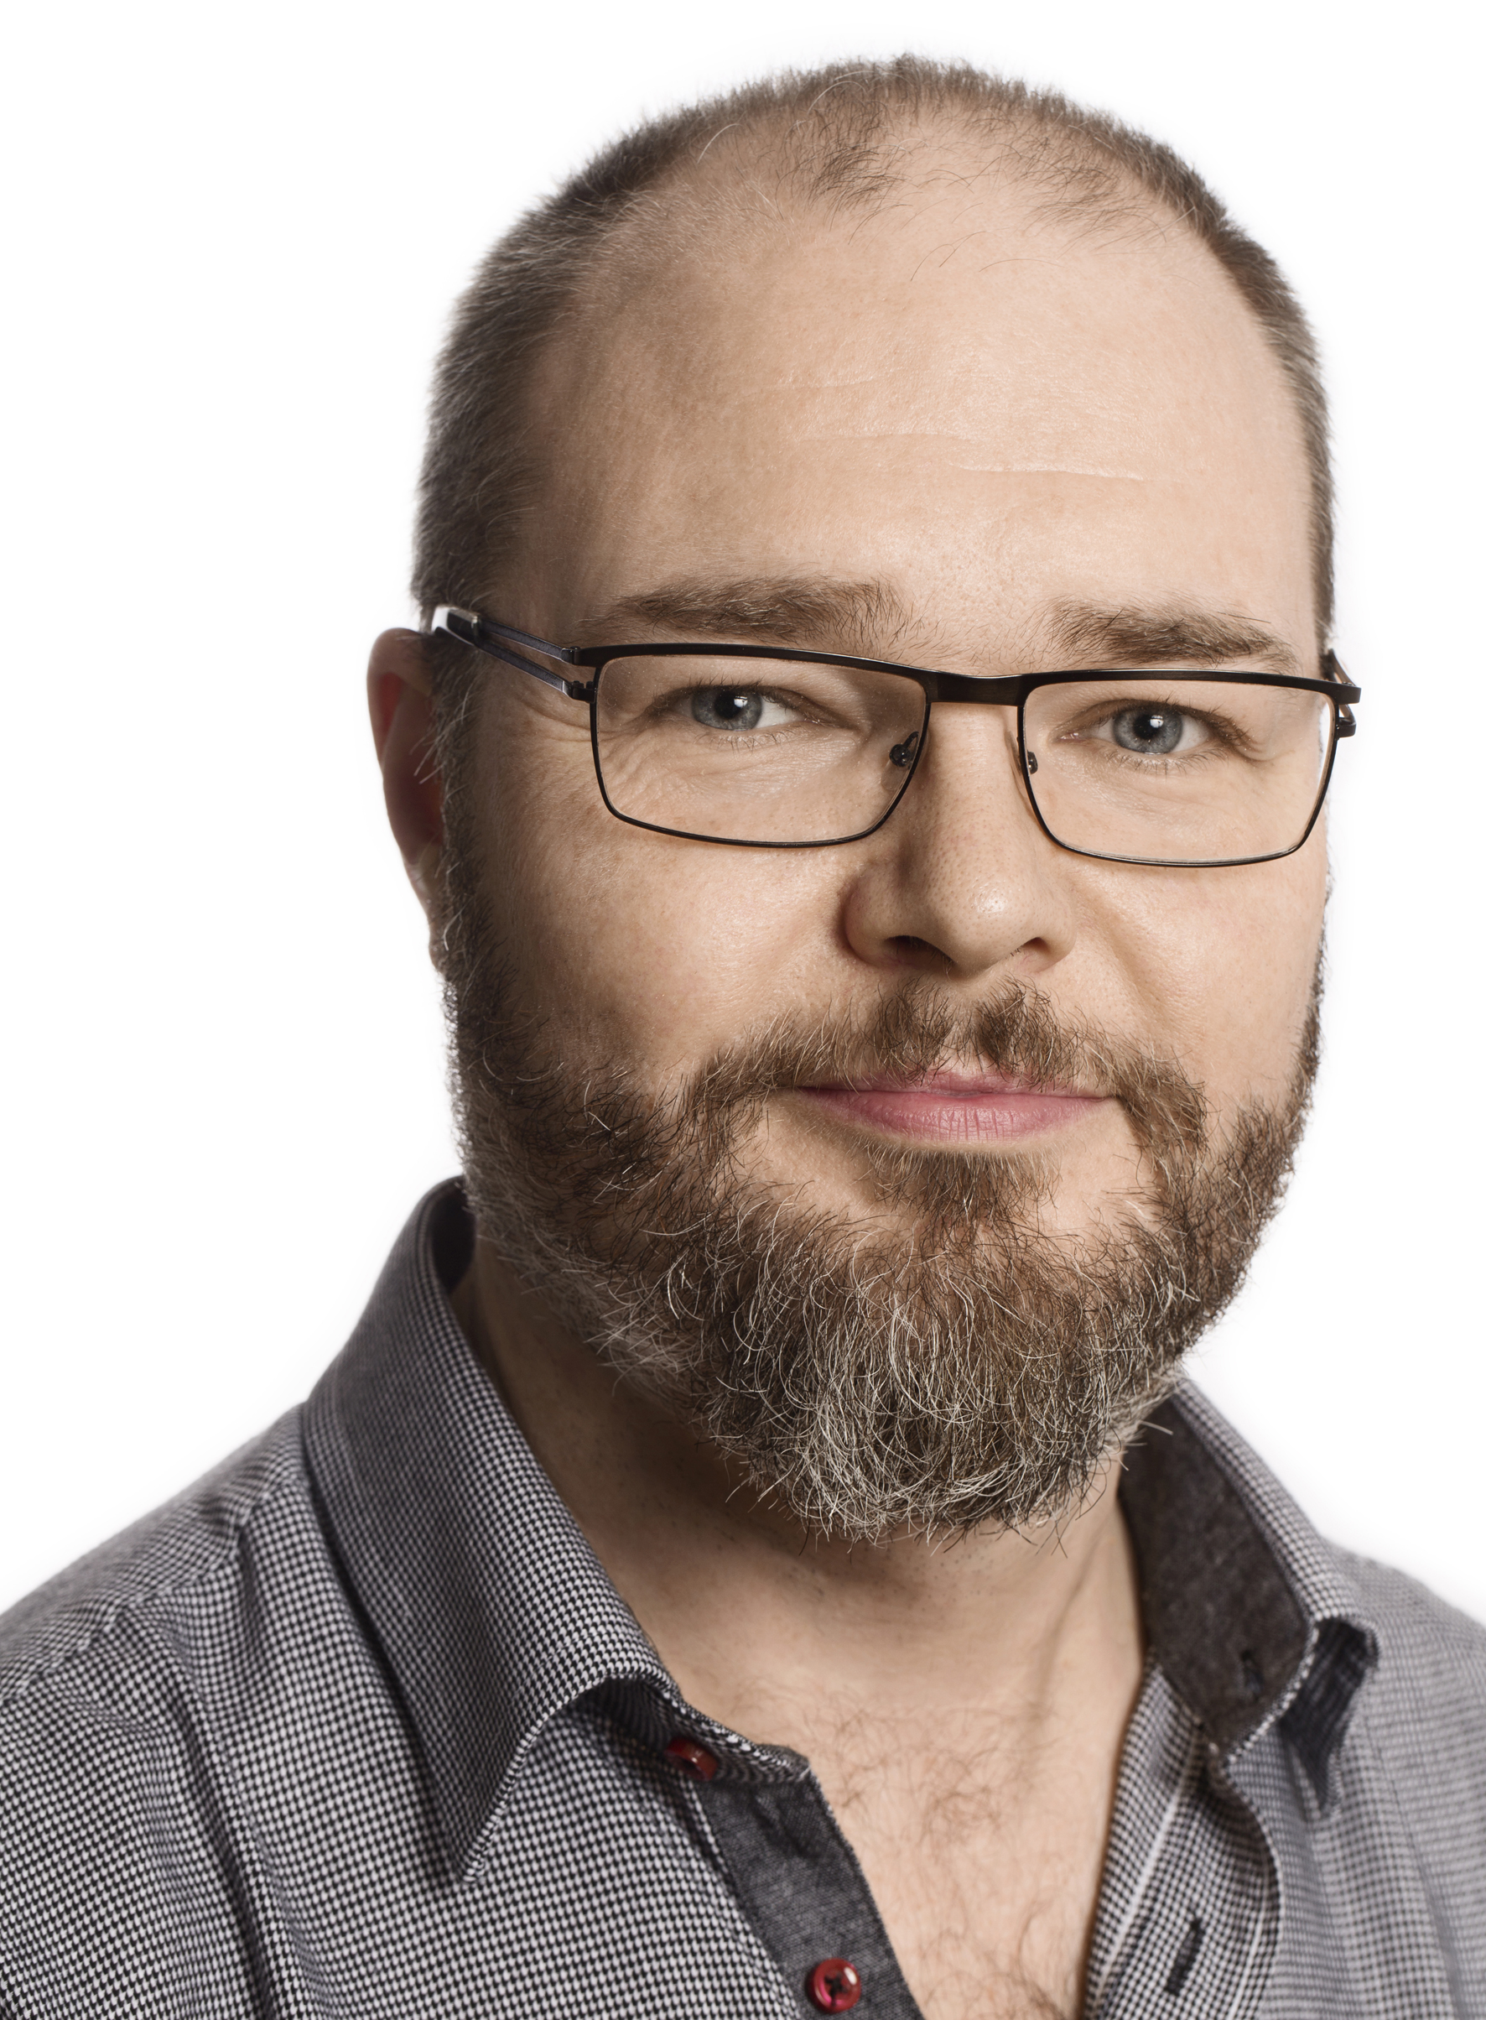
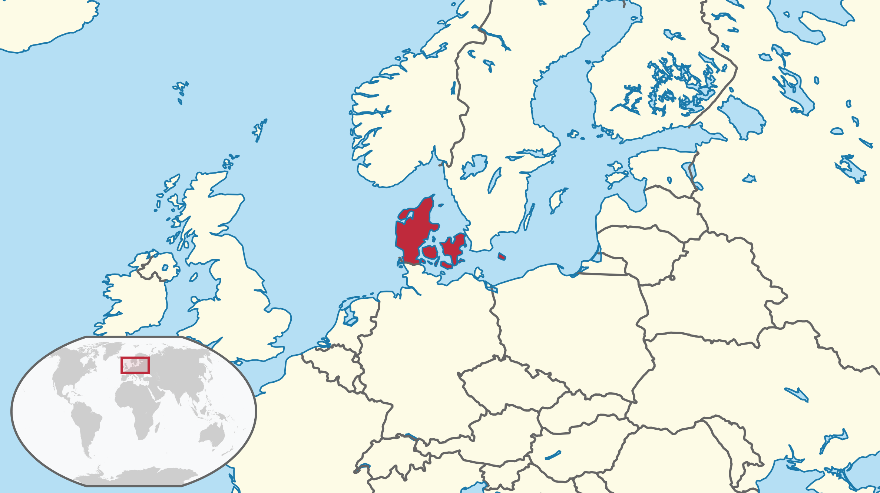

Peter Willendrup
Born 1973 in Copenhagen, DK
BSc. in Physics - RISØ / Univ. CPH 1997 “Neutron diffraction and magnetic structures” (Ho-Er alloys)
Master-courses in X-ray scattering, atomic physics, solid state physics, “computer physics”, numerical analysis
MSc. in Physics, BSc. in Mathematics from Univ. CPH year 2000 “Point-spread Functions in Tomography using Filtered Back-projection Reconstruction” (CT/PET/SPECT scanners)
Software solutions for Neurobiology Research Unit, Copenhagen University Hospital 2000-2002 3D brain-scan visualisation, alignment MR-PET etc…

Slide 3
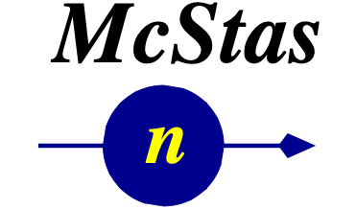






About the lecturer
2002- “development engineer” on the McStas project
2002-2007 Risø National Lab
2007-2011 Risø DTU
2012- DTU Physics
2015- 1/3 seconded to ESS DMSC
External funding from EU projects, ISIS TS2 project, ESS project etc. Currently ESS project +
Daily tasks wrt. McStas:
Develop new functionality - be it physics or infrastructure-wise
Work with users to solve their problems (in any area of neutron scattering…)
Software expert for “anything McStas”
Teach users about the code and how to use it efficiently

Slide 4
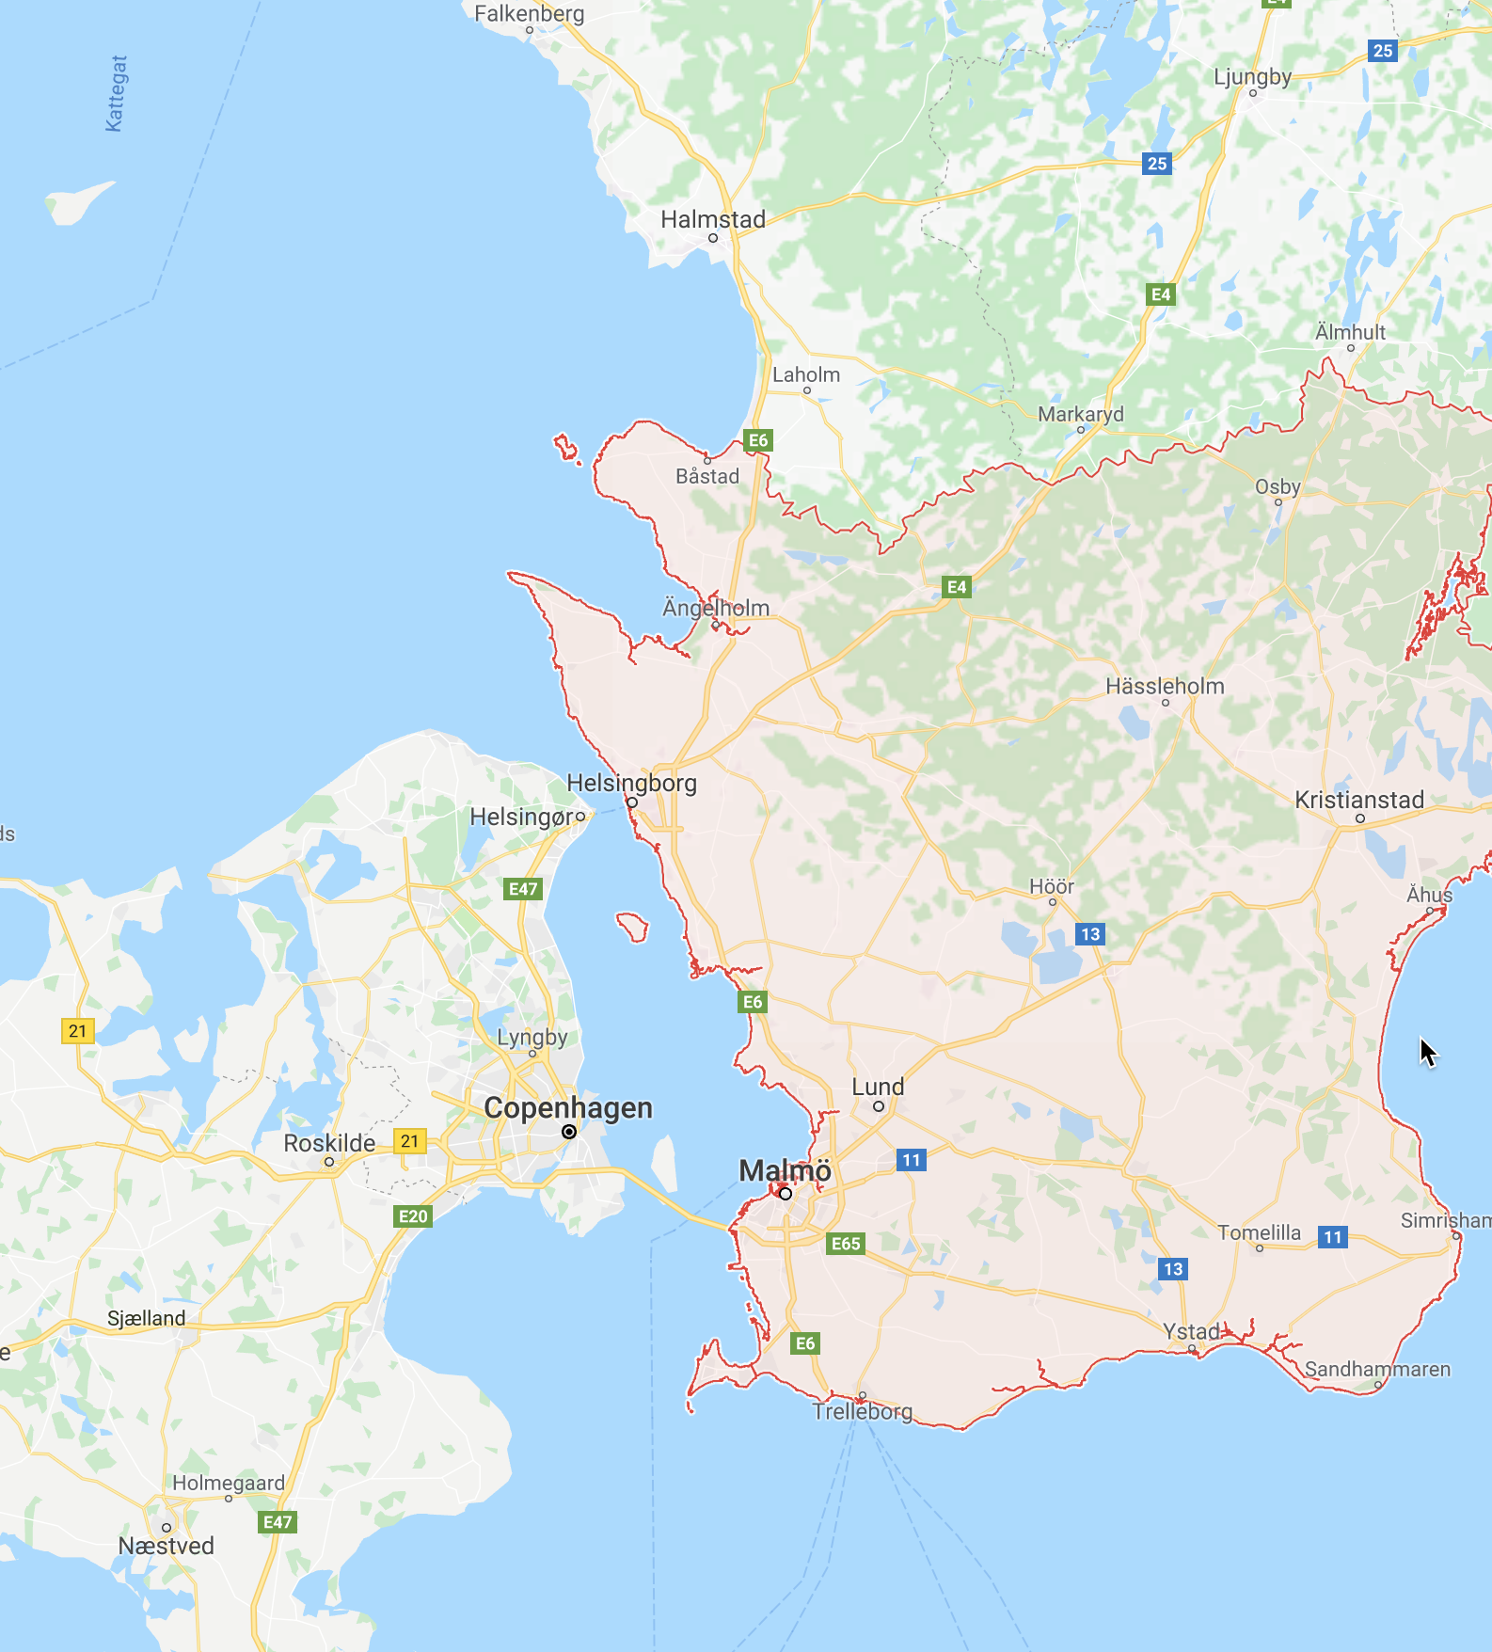
( :-) )
DMSC

Slide 5
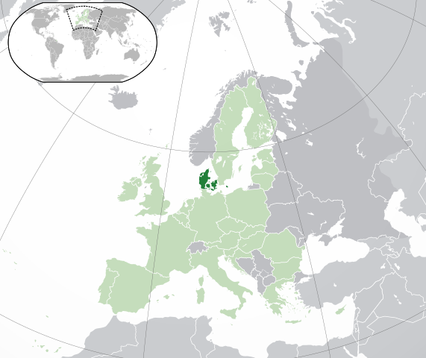
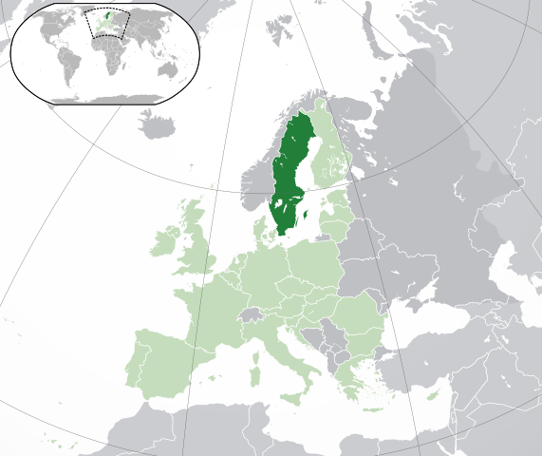
Erik Bergbäck Knudsen
Born 1974 in Finspång, SE
M. Sc. E. E – Lund University, Sweden (“Multi-mode optical Fibers”)
Ph. D. in Fiber Optics Modelling, Technical University of Denmark.
Tomographic Reconstruction Algorithms for X-ray Diffraction Microscopy Data
From 2007 – McStas and McXtrace development

Slide 6
About me:
Responsibilities and Research Interests:
McStas Polarization subsystem
Head developer of McXtrace
Interference effects in photon ray tracing simulations.
Molecular orientation scattering simulations
X-ray Space telescope simulations
McHelium ray tracing He atom beams.

Slide 7
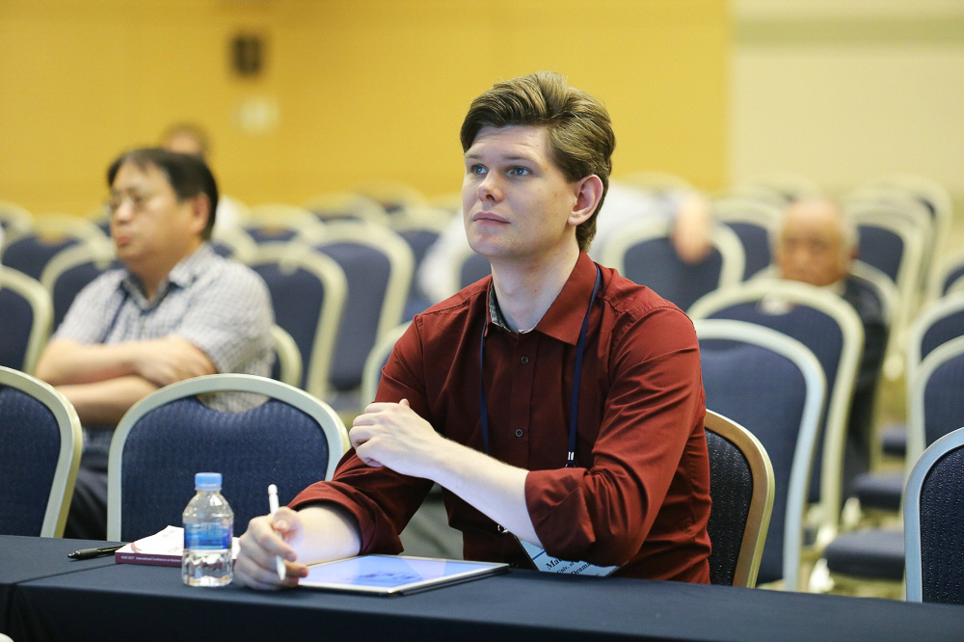
Mads Bertelsen
Born 1988 in Copenhagen, DK
M. Sc. in neutron guide optimization, University of Copenhagen
Ph. D. in neutron instrument simulation, University of Copenhagen
Currently a Post Doc at the European Spallation Source, DMSC

Slide 8
Mads Bertelsen
Research on guide optimization
Minimalist principle – Boundery conditions for optimization
guide_bot automatic guide optimization software
McStas Union expansion
Multiple scattering in complex geometries
Alternate approach to sample physics
Co proposer on 5 ESS Instruments, 3 accepted for construction
Provided large part of data for optics consideration of ESS moderator choice

